Slide 1
Near-Peer Combat Simulation
The Code
The Problem
The Results
The Data
Hayden Burger Corinne Desroches David Lee John Tyler
Notes:
-Clearly define and explain the problem
-Description of data source(s) and curation process(es)
-Proper explanation of the technique/analysis methods applied to the problem
-Effective explanation of computational approach (i.e. code review)
-Accurately and effectively presents and visualizes results

Slide 2
Which Pokemon is the best?
Pokemon: game franchise where players battle with teams of fantasy creatures
Rock-paper-scissors style elemental types give advantage and disadvantage
Speed, attack, defense, type advantage, hit points, status effects, movesets
Elements of strategy and luck
We will use a Monte Carlo simulation to get an idea of which individual Pokémon has the highest win rate
The Code
The Problem
The Results
The Data
Notes:
What is a type?

Slide 3
Assumptions and simplifications
A simulation of 1000 battles between each pokemon and its 150 competitors is a sufficient sample size
Only Generation 1
Only Level 1
Full battle equation is in effect
PP (move use limits) are ignored
The Code
The Problem
The Results
The Data
Notes:
1025 pokemon
9 generations
19 types
What is a Generation?

Slide 4
Four major sources of data
Pokemon.csv
Kaggle.com dataset scraped by user 'ROUNAK BANIK' from http://serebii.net/
MovesetGen1.xlsx
Pokemondb.net move set cut and paste into excel from https://pokemondb.net/move/generation/1
Moveset.csv
Kaggle.com dataset scraped by user 'KEITH SANDERS' from https://pokemondb.net
Moveset_per_pokemon.csv
Bulbapedia Gen 1 move set cut and paste by a member frustrated at the inconsistency of the html code on Bulbapedia
The Code
The Problem
The Results
The Data

Slide 5
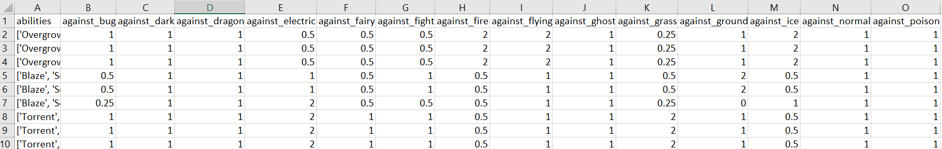
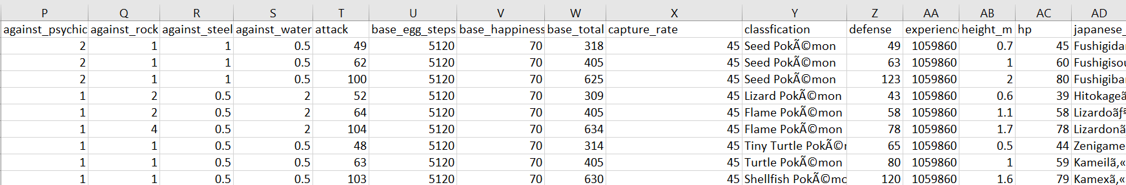
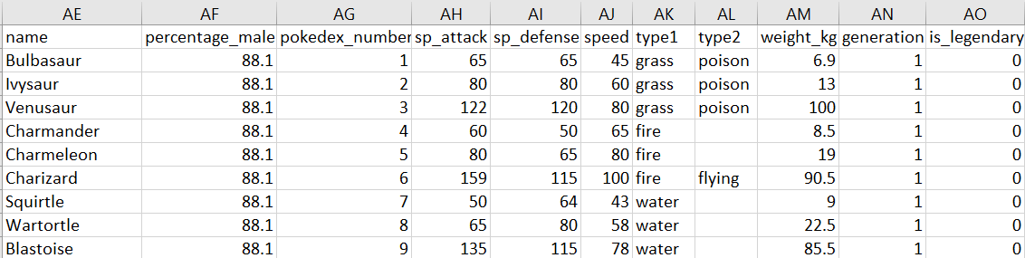
Pokemon.csv: 802 rows x 41 columns
Kaggle.com scraped by user ALBERTO BARRADAS
The Code
The Problem
The Results
The Data

Slide 6
Pokemon.csv: 802 rows x 41 columns
Kaggle.com scraped by user ALBERTO BARRADAS
The Code
The Problem
The Results
The Data

Slide 7
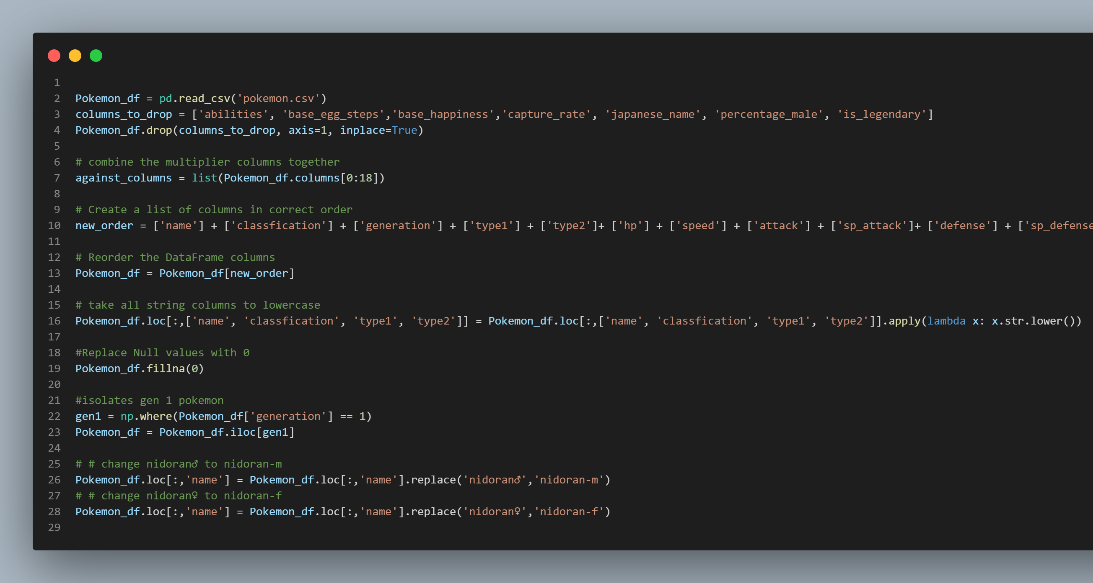

Pokemon_df:
The Code
The Problem
The Results
The Data

Slide 8
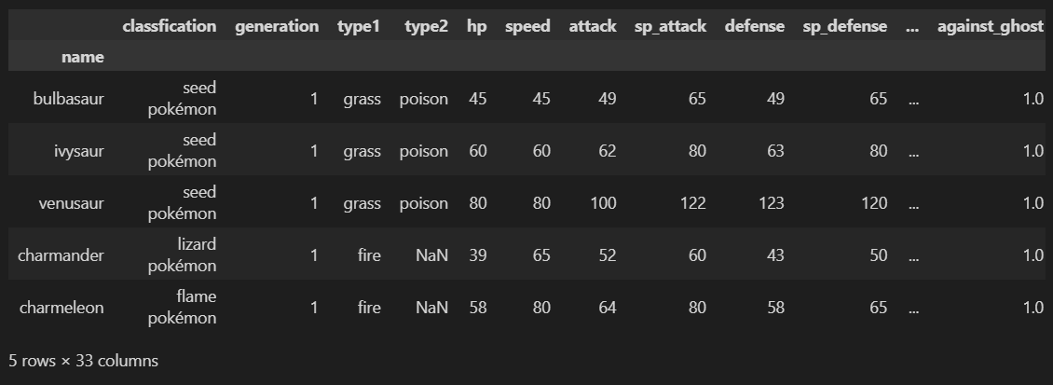
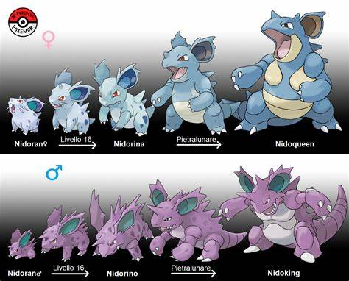
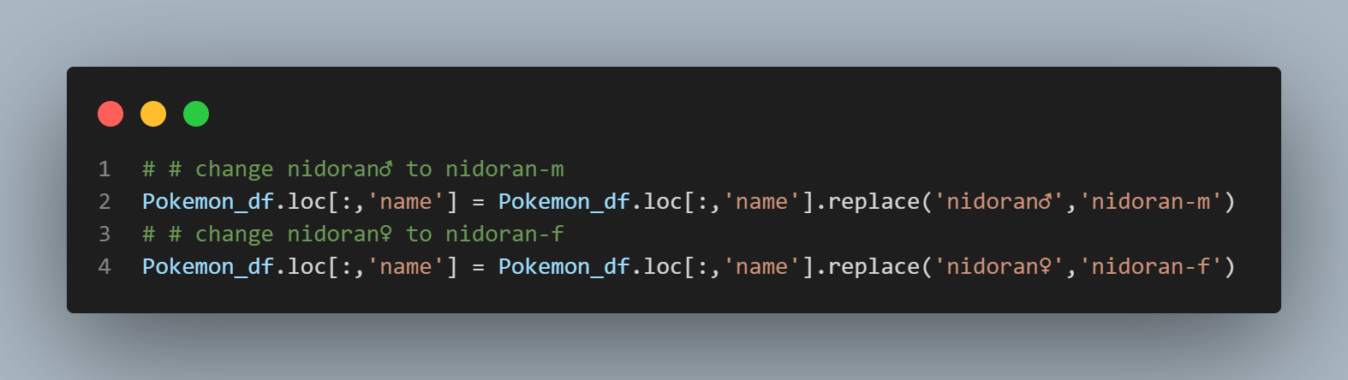
Pokemon_df:
The Code
The Problem
The Results
The Data

Slide 9
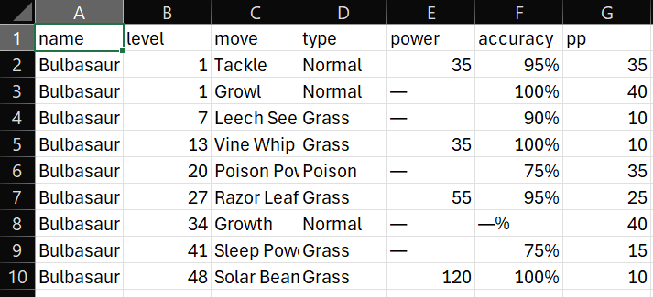
Moveset_per_pokemon.csv:
Bulbapedia Gen 1 move set cut and paste
The Code
The Problem
The Results
The Data

Slide 10
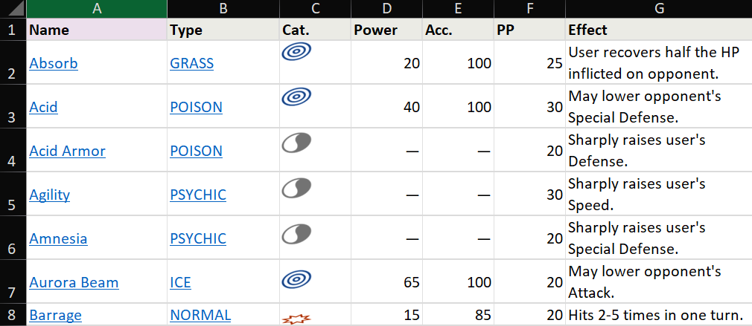
MovesetGen1.xlsx:
Pokemondb.net move set cut and paste
The Code
The Problem
The Results
The Data

Slide 11
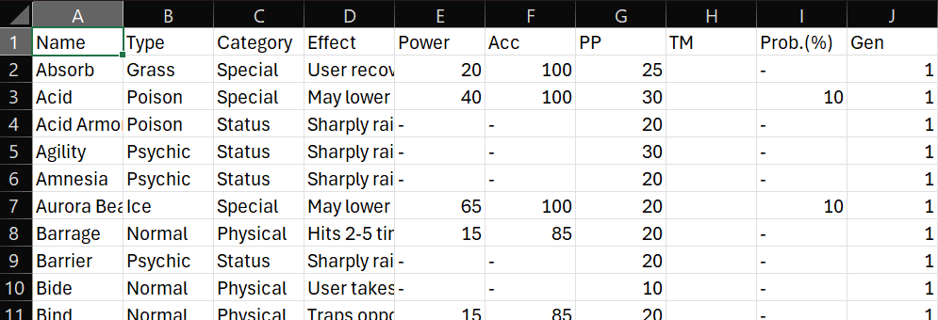
Moveset.csv
Kaggle.com dataset scraped by user 'KEITH SANDERS'
The Code
The Problem
The Results
The Data

Slide 12
Cleaning Workflow:
Moveset.csv - AMoveset_df
Moveset_per_pokemon.csv - L1_moves_df
MovesetGen1.xlsx -BMoveset_df
Merged_moves_df
Format strings
Type cast columns
Fix
discrepancies
Reindex Dataframe
Read in data
The Code
The Problem
The Results
The Data

Slide 13
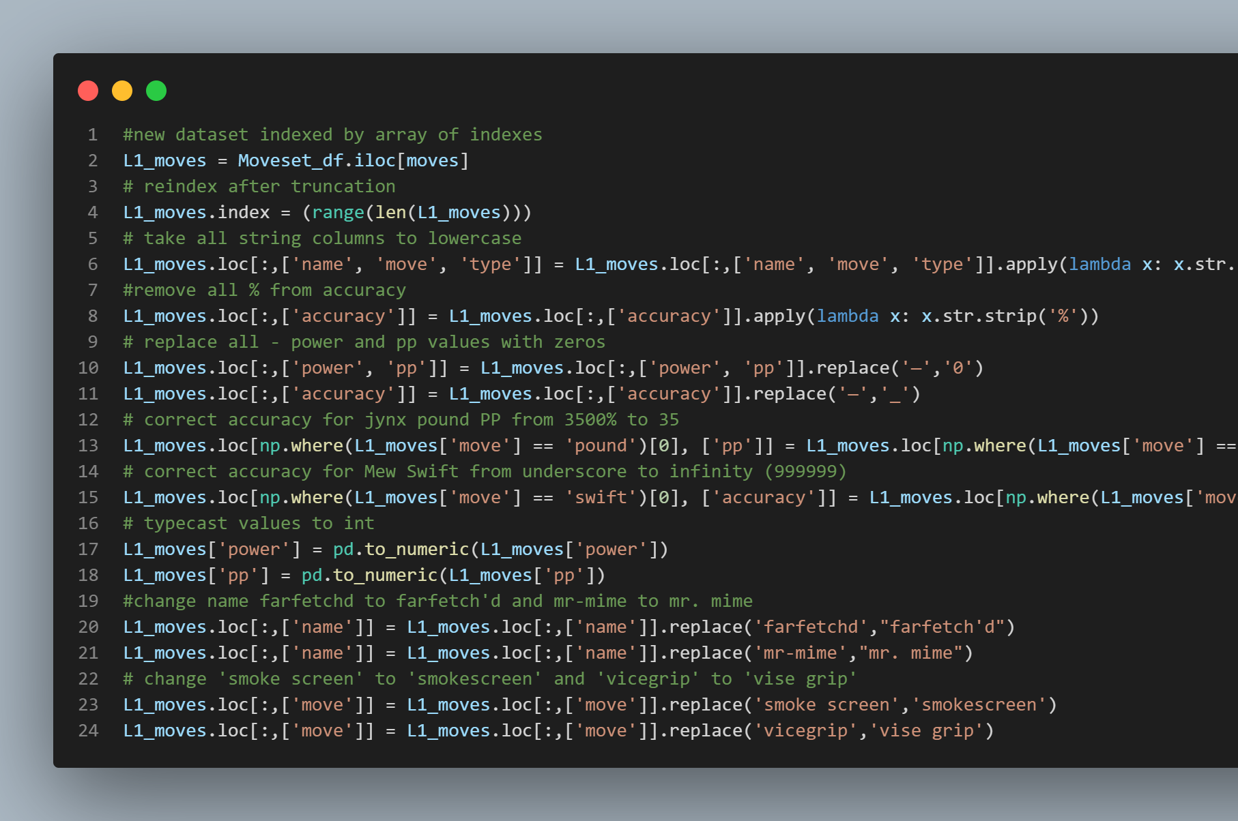


The Code
The Problem
The Results
The Data

Slide 14
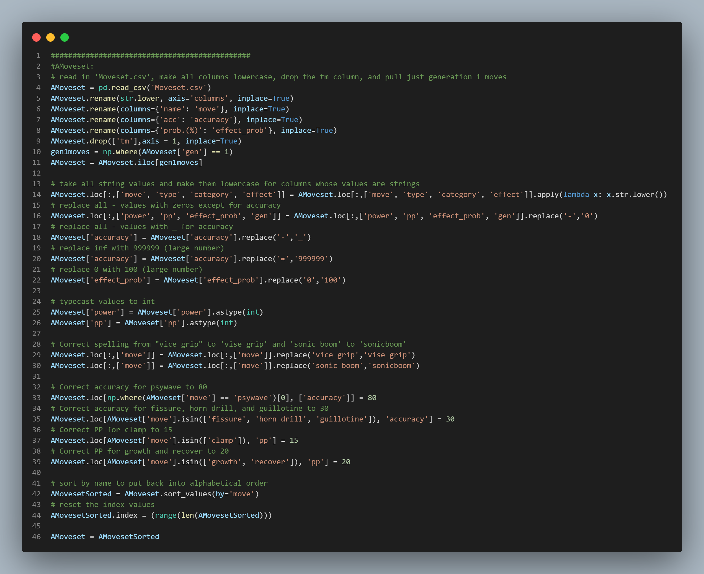


The Code
The Problem
The Results
The Data

Slide 15
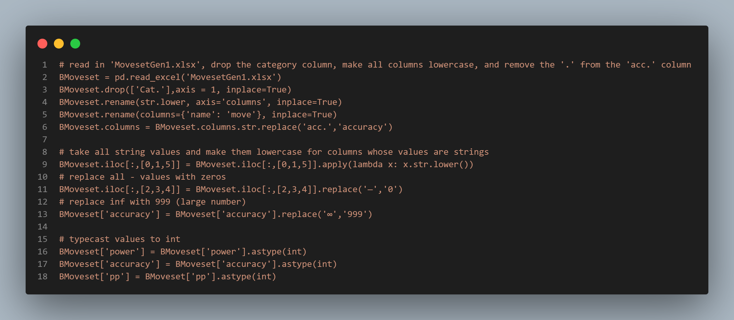
The Code
The Problem
The Results
The Data

Slide 16
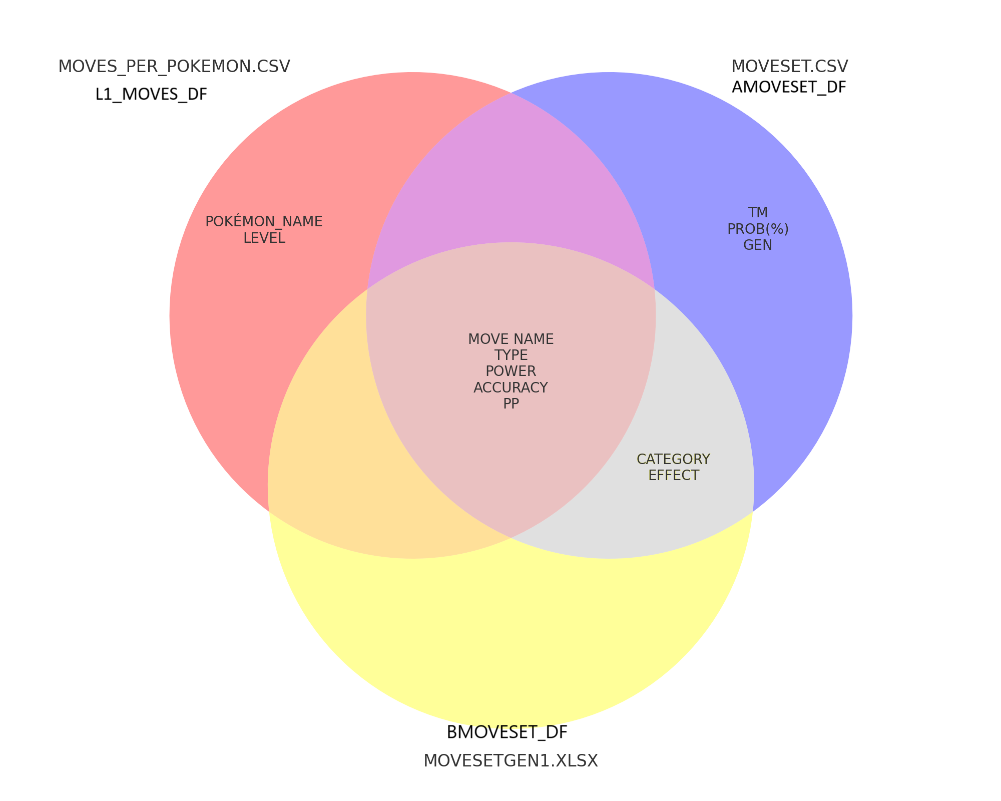
The Code
The Problem
The Results
The Data

Slide 17
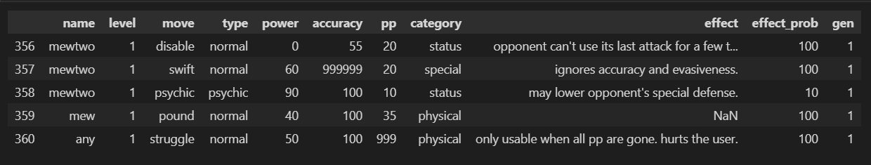
Merged_moves_df:
The Code
Pokemon_df
The Problem
The Results
The Data

Slide 18
The Code
The Problem
The Results
The Data

Slide 19
The Code
The Problem
The Results
The Data

Slide 20
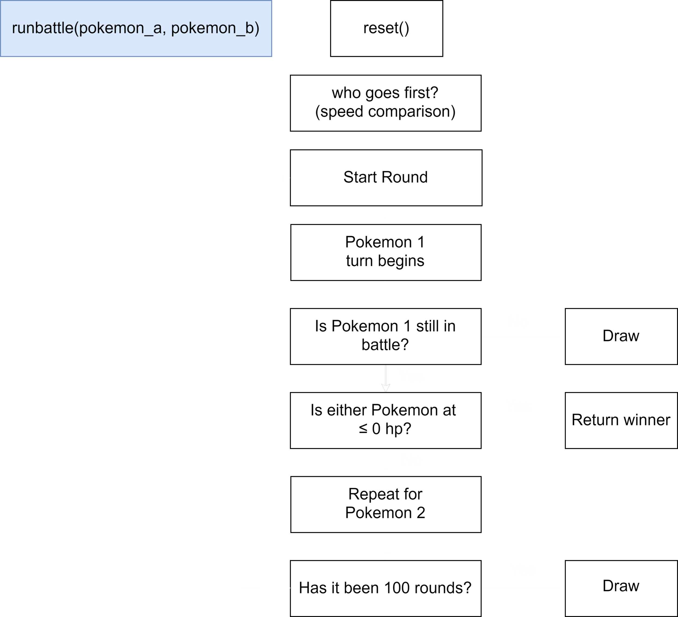


The Code
The Problem
The Results
The Data

Slide 21
The Code
The Problem
The Results
The Data

Slide 22
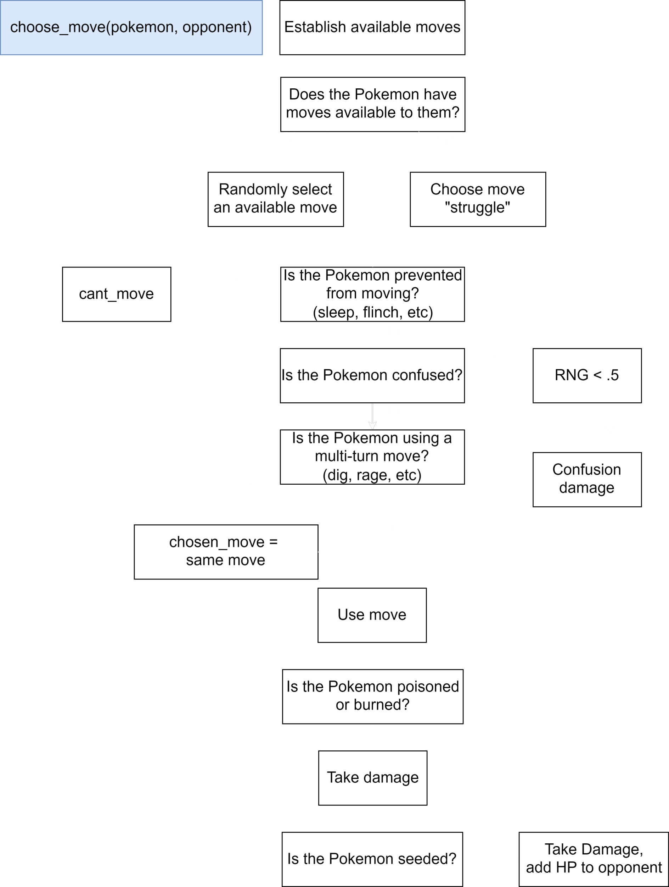

The Code
The Problem
The Results
The Data

Slide 23

The Code
The Problem
The Results
The Data

Slide 24
The Code
The Problem
The Results
The Data

Slide 25
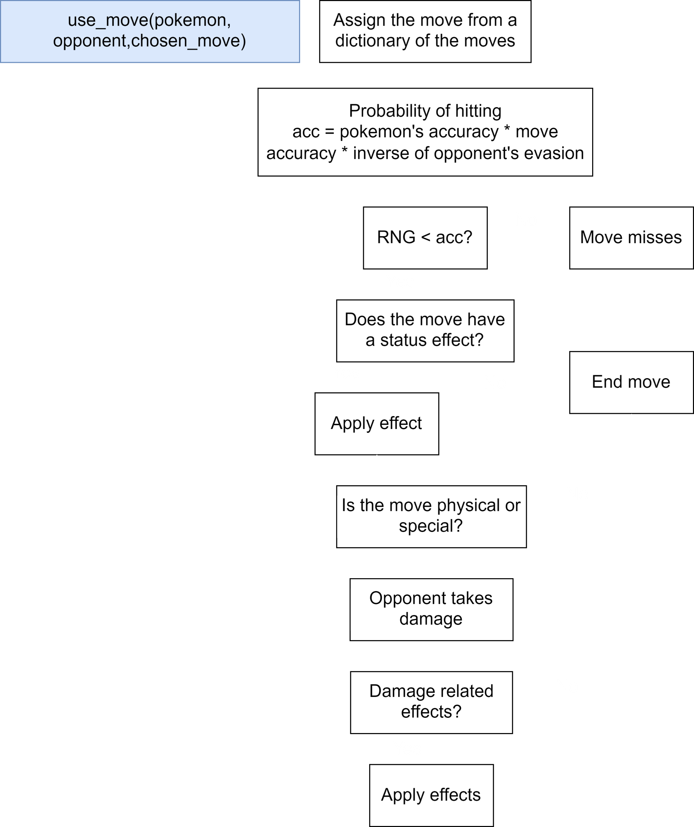
The Code
The Problem
The Results
The Data

Slide 26
The Code
The Problem
The Results
The Data

Slide 27
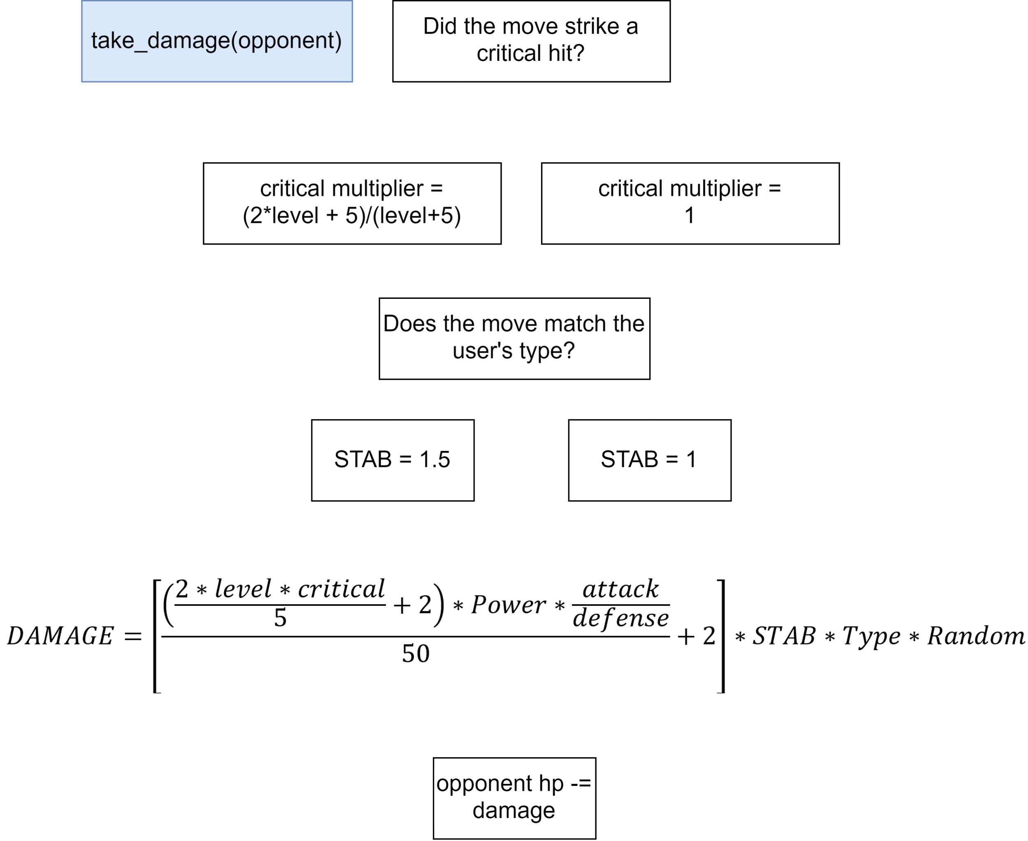
The Code
The Problem
The Results
The Data

Slide 28
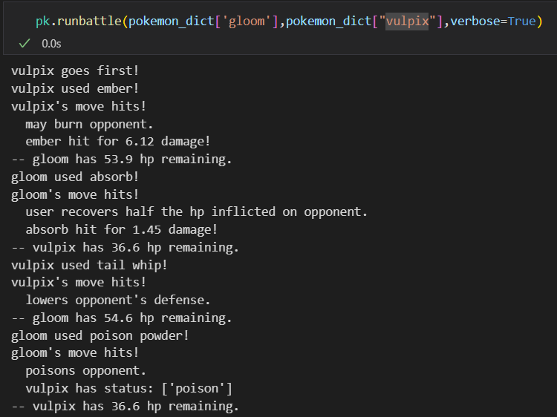


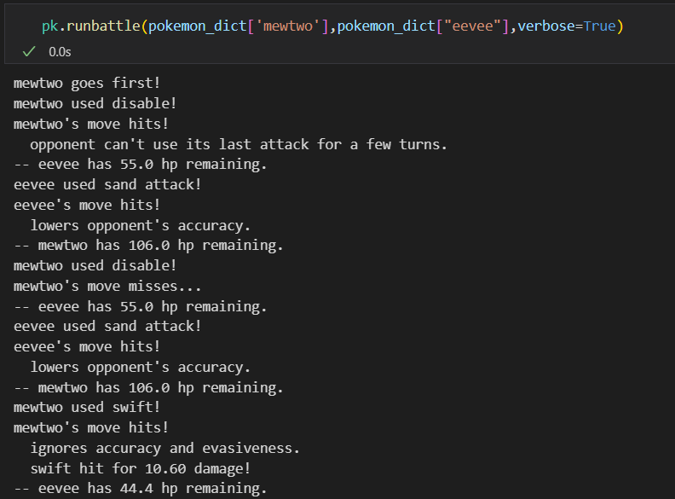
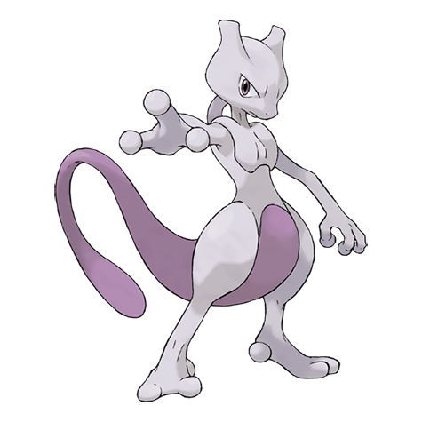

The Code
The Problem
The Results
The Data

Slide 29
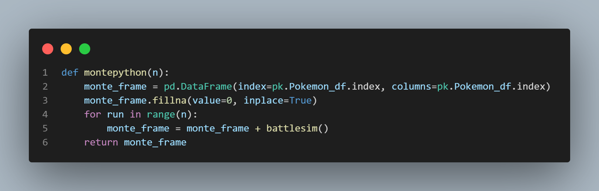
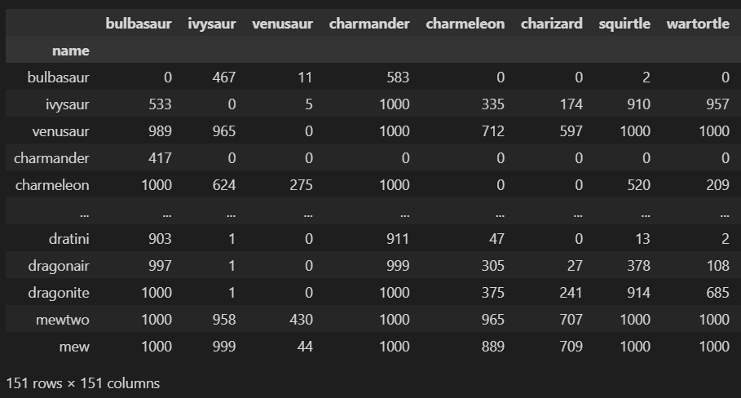
The Code
The Problem
The Results
The Data

Slide 30






5
4
1
3
2

Slide 31





Slide 32
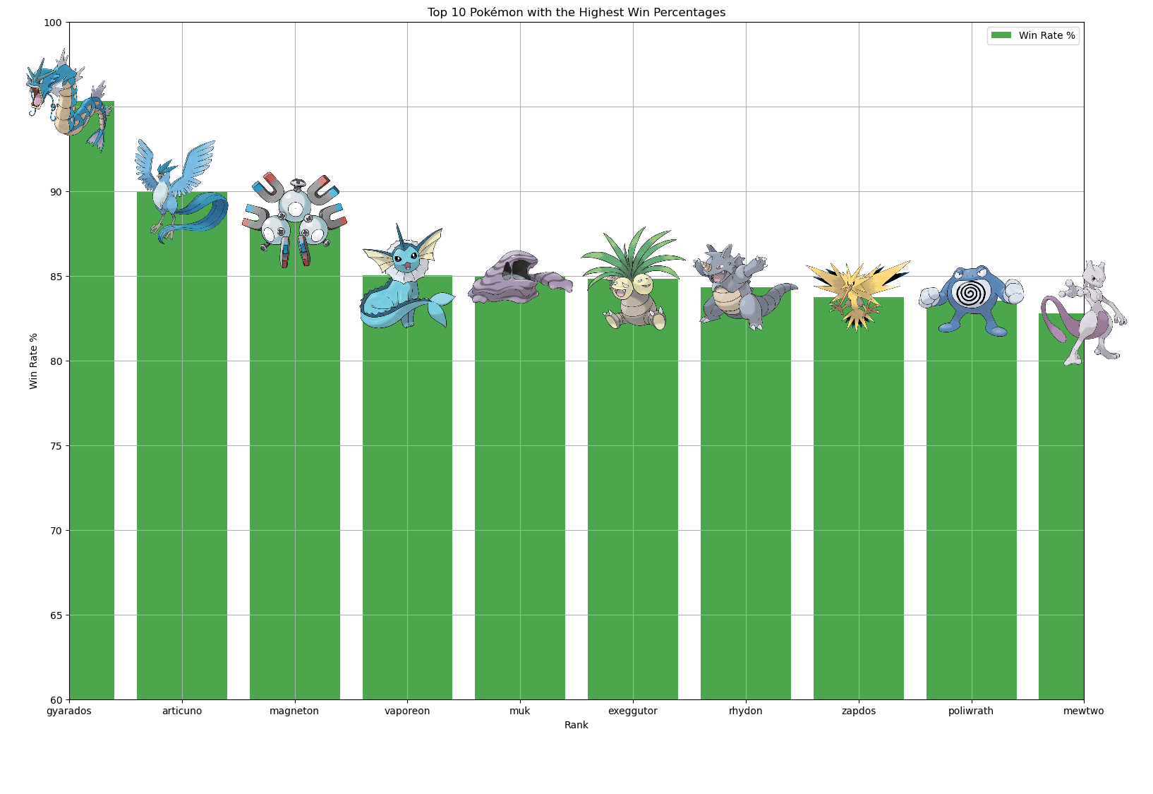
The Code
The Problem
The Results
The Data

Slide 33
Dragon rage
Ice Beam
Sonic Boom
Well Rounded
The Code
The Problem
The Results
The Data

Slide 34
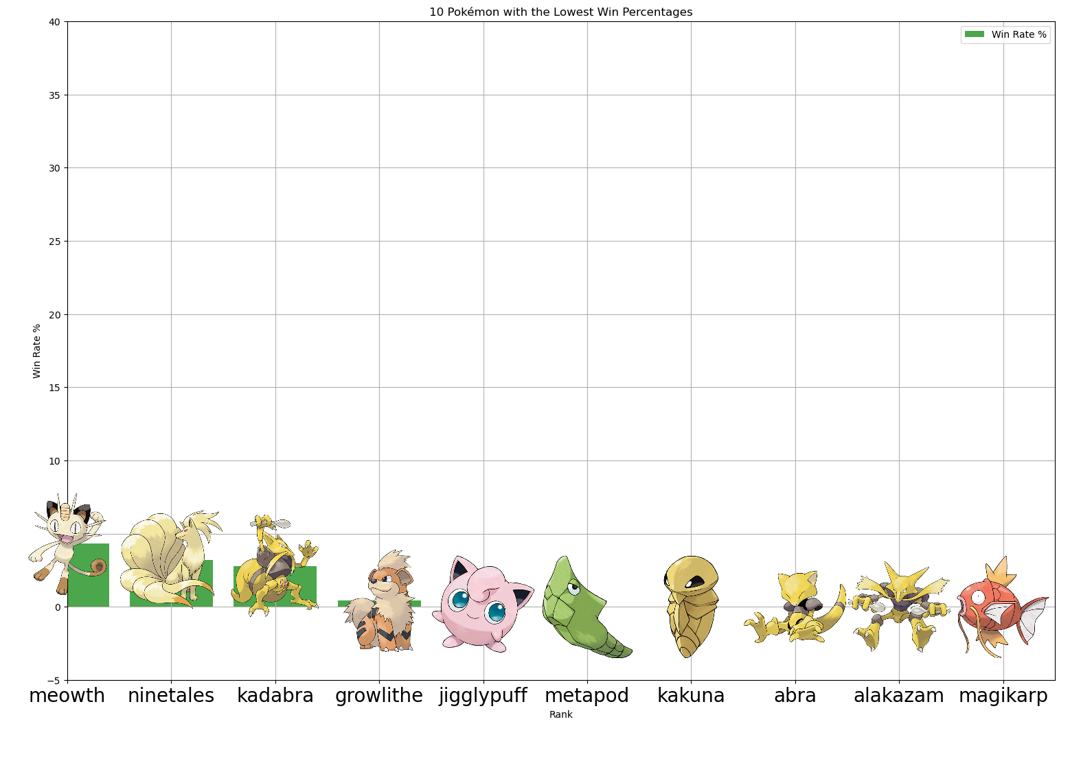
The Code
The Problem
The Results
The Data

Slide 35
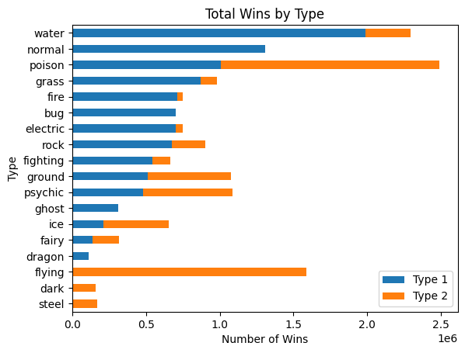
The Code
The Problem
The Results
The Data

Slide 36
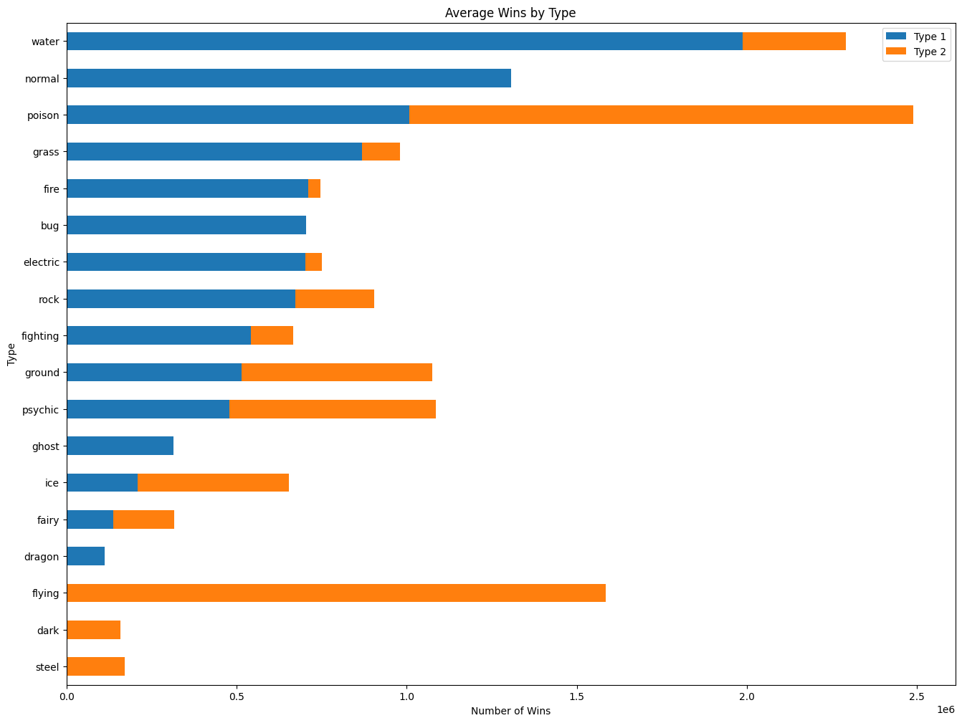

The Code
The Problem
Questions
The Results
The Data

Slide 37
Streamlit Dashboard
The Code
The Problem
Questions
The Results
The Data

Slide 38
The Code
The Problem
The Results
The Data
Questions

Slide 39
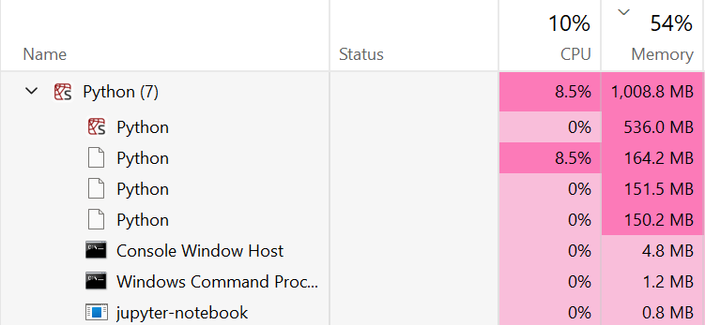
The Code
The Problem
The Results
The Data

